Slide 1
16.1 Purposes of an Operating System (OS)
Show understanding of how an OS can maximize the use of resources
Describe the ways in which the user interface hides the complexities of the hardware from the user
Show understanding of processor management: multitasking, including:
– the concept of multitasking and a process
– the process states: running, ready and blocked
– the need for scheduling
– the concept of an interrupt
– how the kernel of the OS acts as the interrupt handler and how interrupt handling is used to manage low-level scheduling
Show understanding of paging for memory management: including:
– the concepts of paging and virtual memory
– the need for paging
– how pages can be replaced
– how disk thrashing can occur

Slide 2
Today
Show understanding of how an OS can maximize the use of resources
Describe the ways in which the user interface hides the complexities of the hardware from the user
Show understanding of processor management: multitasking, including:
– the concept of multitasking and a process
– the process states: running, ready and blocked
– the need for scheduling
– the concept of an interrupt
– how the kernel of the OS acts as the interrupt handler and how interrupt handling is used to manage low-level scheduling
Show understanding of paging for memory management: including:
– the concepts of paging and virtual memory
– the need for paging
– how pages can be replaced
– how disk thrashing can occur
Understand: Advanced features of an OS
Able: Explain paging
Answer: What is a kernel and what does it do?

Slide 3
Initially
Your computer has many programs on its hard drive. Example: Photoshop
Your computer is powered off.
You turn it on.
You want Photoshop
Does Photoshop load right away or do you have to tell the computer to load it?
But what about your Operating System (OS)
Its just another program on your hard drive, so how can you turn on a computer and a computer knows to load your OS?

Slide 4
Startup
You turn on a computer
The computer looks in the ROM(Read Only Memory)
The ROM is where your BIOS (Basic Input Output System) is stored
As part of your BIOS, there is a bootstrap program
The bootstrap program loads your OS into memory (RAM)
That is what Cambridge says. Actually its very outdated because now you will get a separate BIOS chip and non- volatile RAM (Its why Windows 10 loads without a BIOS) but we don’t need to know that right now.

Slide 5
Job of an OS
An OS is the link between you and the hardware
When you want a program (like Photoshop), you click on it. The OS then stores this program in memory
Your OS can load many programs into memory
But only one program can access the CPU at a time. The others will be ready when your CPU is free. This is multi-programming and happens when there is only one user on the computer
If there are many users logged in at the same time then this is a time sharing system

Slide 6
What does an OS do?
Resource Management
Input / Output system
Facilities for user
Scheduling
Interrupts
Memory management

Slide 7
Resource Management
We said that many programs can be stored in memory, but only one program can use a CPU at any one time. The others have to wait and be scheduled.
This is resource management. How a CPU is efficiently used in terms of memory management
This is only for single CPU, not multiple processor systems.
We will talk more about this later.

Slide 8
Input / Output (IO) system
Input:
Keyboard
Mouse
Microphone
Output:
Monitor
Speakers
Printer
But when talk about how an OS handles IO we don’t just mean devices
IO refers to the input and output to and from storage devices when a program is running

Slide 9
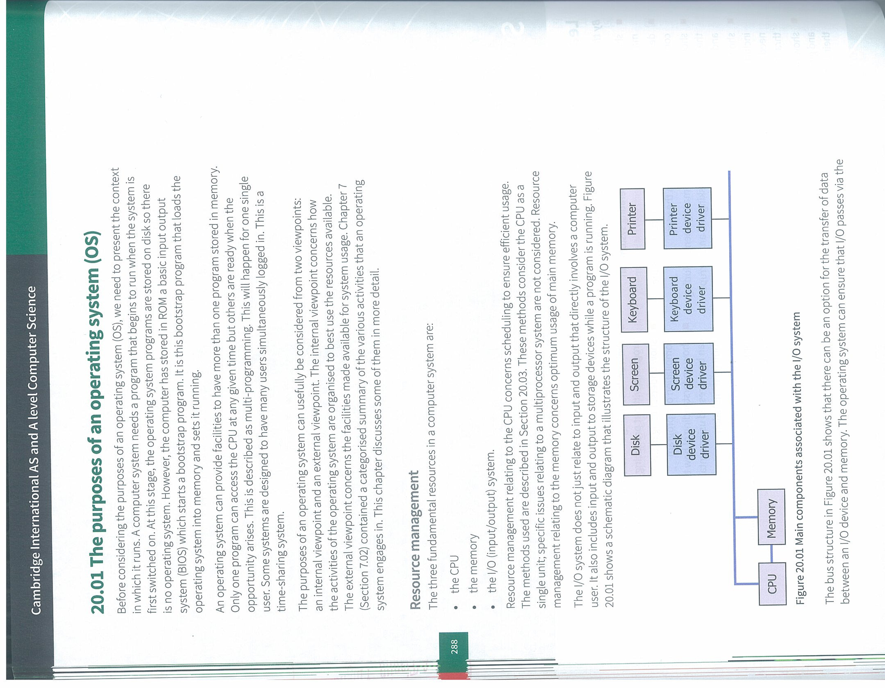
IO
The diagram (taken from page 288) shows that devices connect to a driver which can go to either the CPU or Memory. The OS can decide if data goes to the CPU or memory. For large amounts of data, its quicker to go direct to memory
A driver is a software program attached to a device. It has information about the hardware device so the OS does not need to know everything about the hardware it just deals with the driver.

Slide 10
IO and CPU
The aim of the OS is to make sure the CPU is always doing something. And CPUs can do things very quickly.
Now, CPU speed is measured in Gigahertz GHz, which means in one second a CPU has 1,000,000,000 (1 trillion) cycles for 1GHz.
Device | Data rate | Time for 1 byte
Keyboard | 10 Bps (bits per second) | 0.1seconds
Monitor | 50 MBps (Megabits ps) | 2 x 10⁻⁸s
Hard drivee | 5 MBps (Megabits ps) | 2 x 10⁻⁷s

Slide 11
Facilities for user
1. A user must interface with the computer using the OS. It can be using:
Command Line / Terminal
Graphical User Interface (GUI)
Voice recognition
Gesture recognition
2. An OS also uses a file system. A user can choose the name of a file and where to store it in a directory but the OS handles where it actually is stored on your hard drive
3. An OS can also handle programming environments so a programmer writing code only needs to care about their code and not the processor architecture
4. System calls. If a program needs something it tells the OS and the OS does it. That’s a system call. Example if a program needs to find a file.
5. API. Application Programming Interface (API). An API can be one or many system calls in one package. It does a task completely and its portable. So an API that is written for Windows 10 will work on all Windows 10 machines. And an API is used to do a task such as creating icons or menu items. API nearly always relate to graphical elements on a GUI

Slide 12
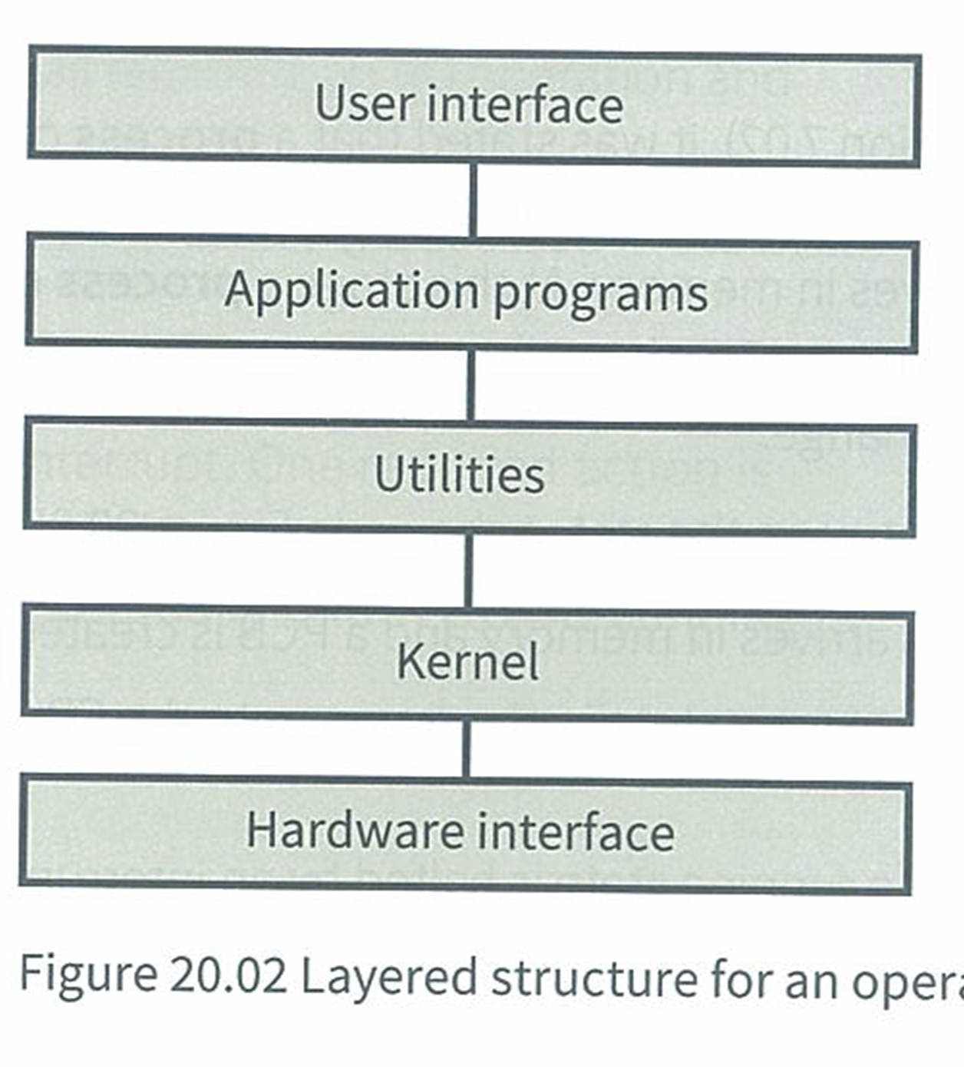
How an OS is structured
An OS has to handle two main things.
Facilities for the user
Resource Management
The resource management is handled by the
Kernel.
This diagram shows a layered OS model.
Its not really used because for it to work, the layers below must be running.

Slide 13
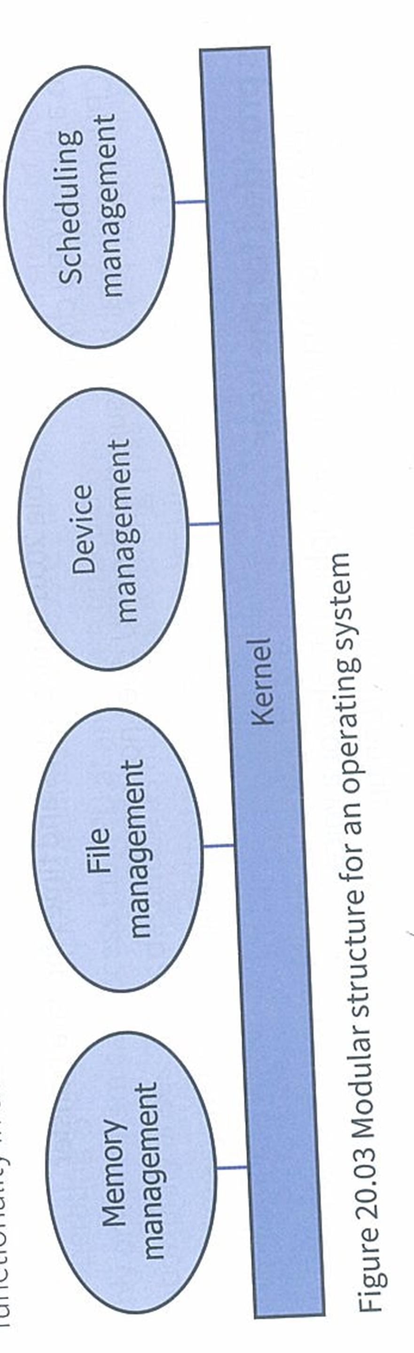
Kernel
Instead of that layered model, most OSs have a modular kernel.
The part of the OS that talks with the hardware rather than the user.
A user is super unlikely to ever touch the kernel
The kernel usually runs all of the time

Slide 14
Process Scheduling
So far we have done:
What an OS does
Input / Output
How an OS is structured
We know an OS links between hardware and the user and it manages the CPU and memory. But how does an OS know what to tell the CPU?
This is process scheduling

Slide 15
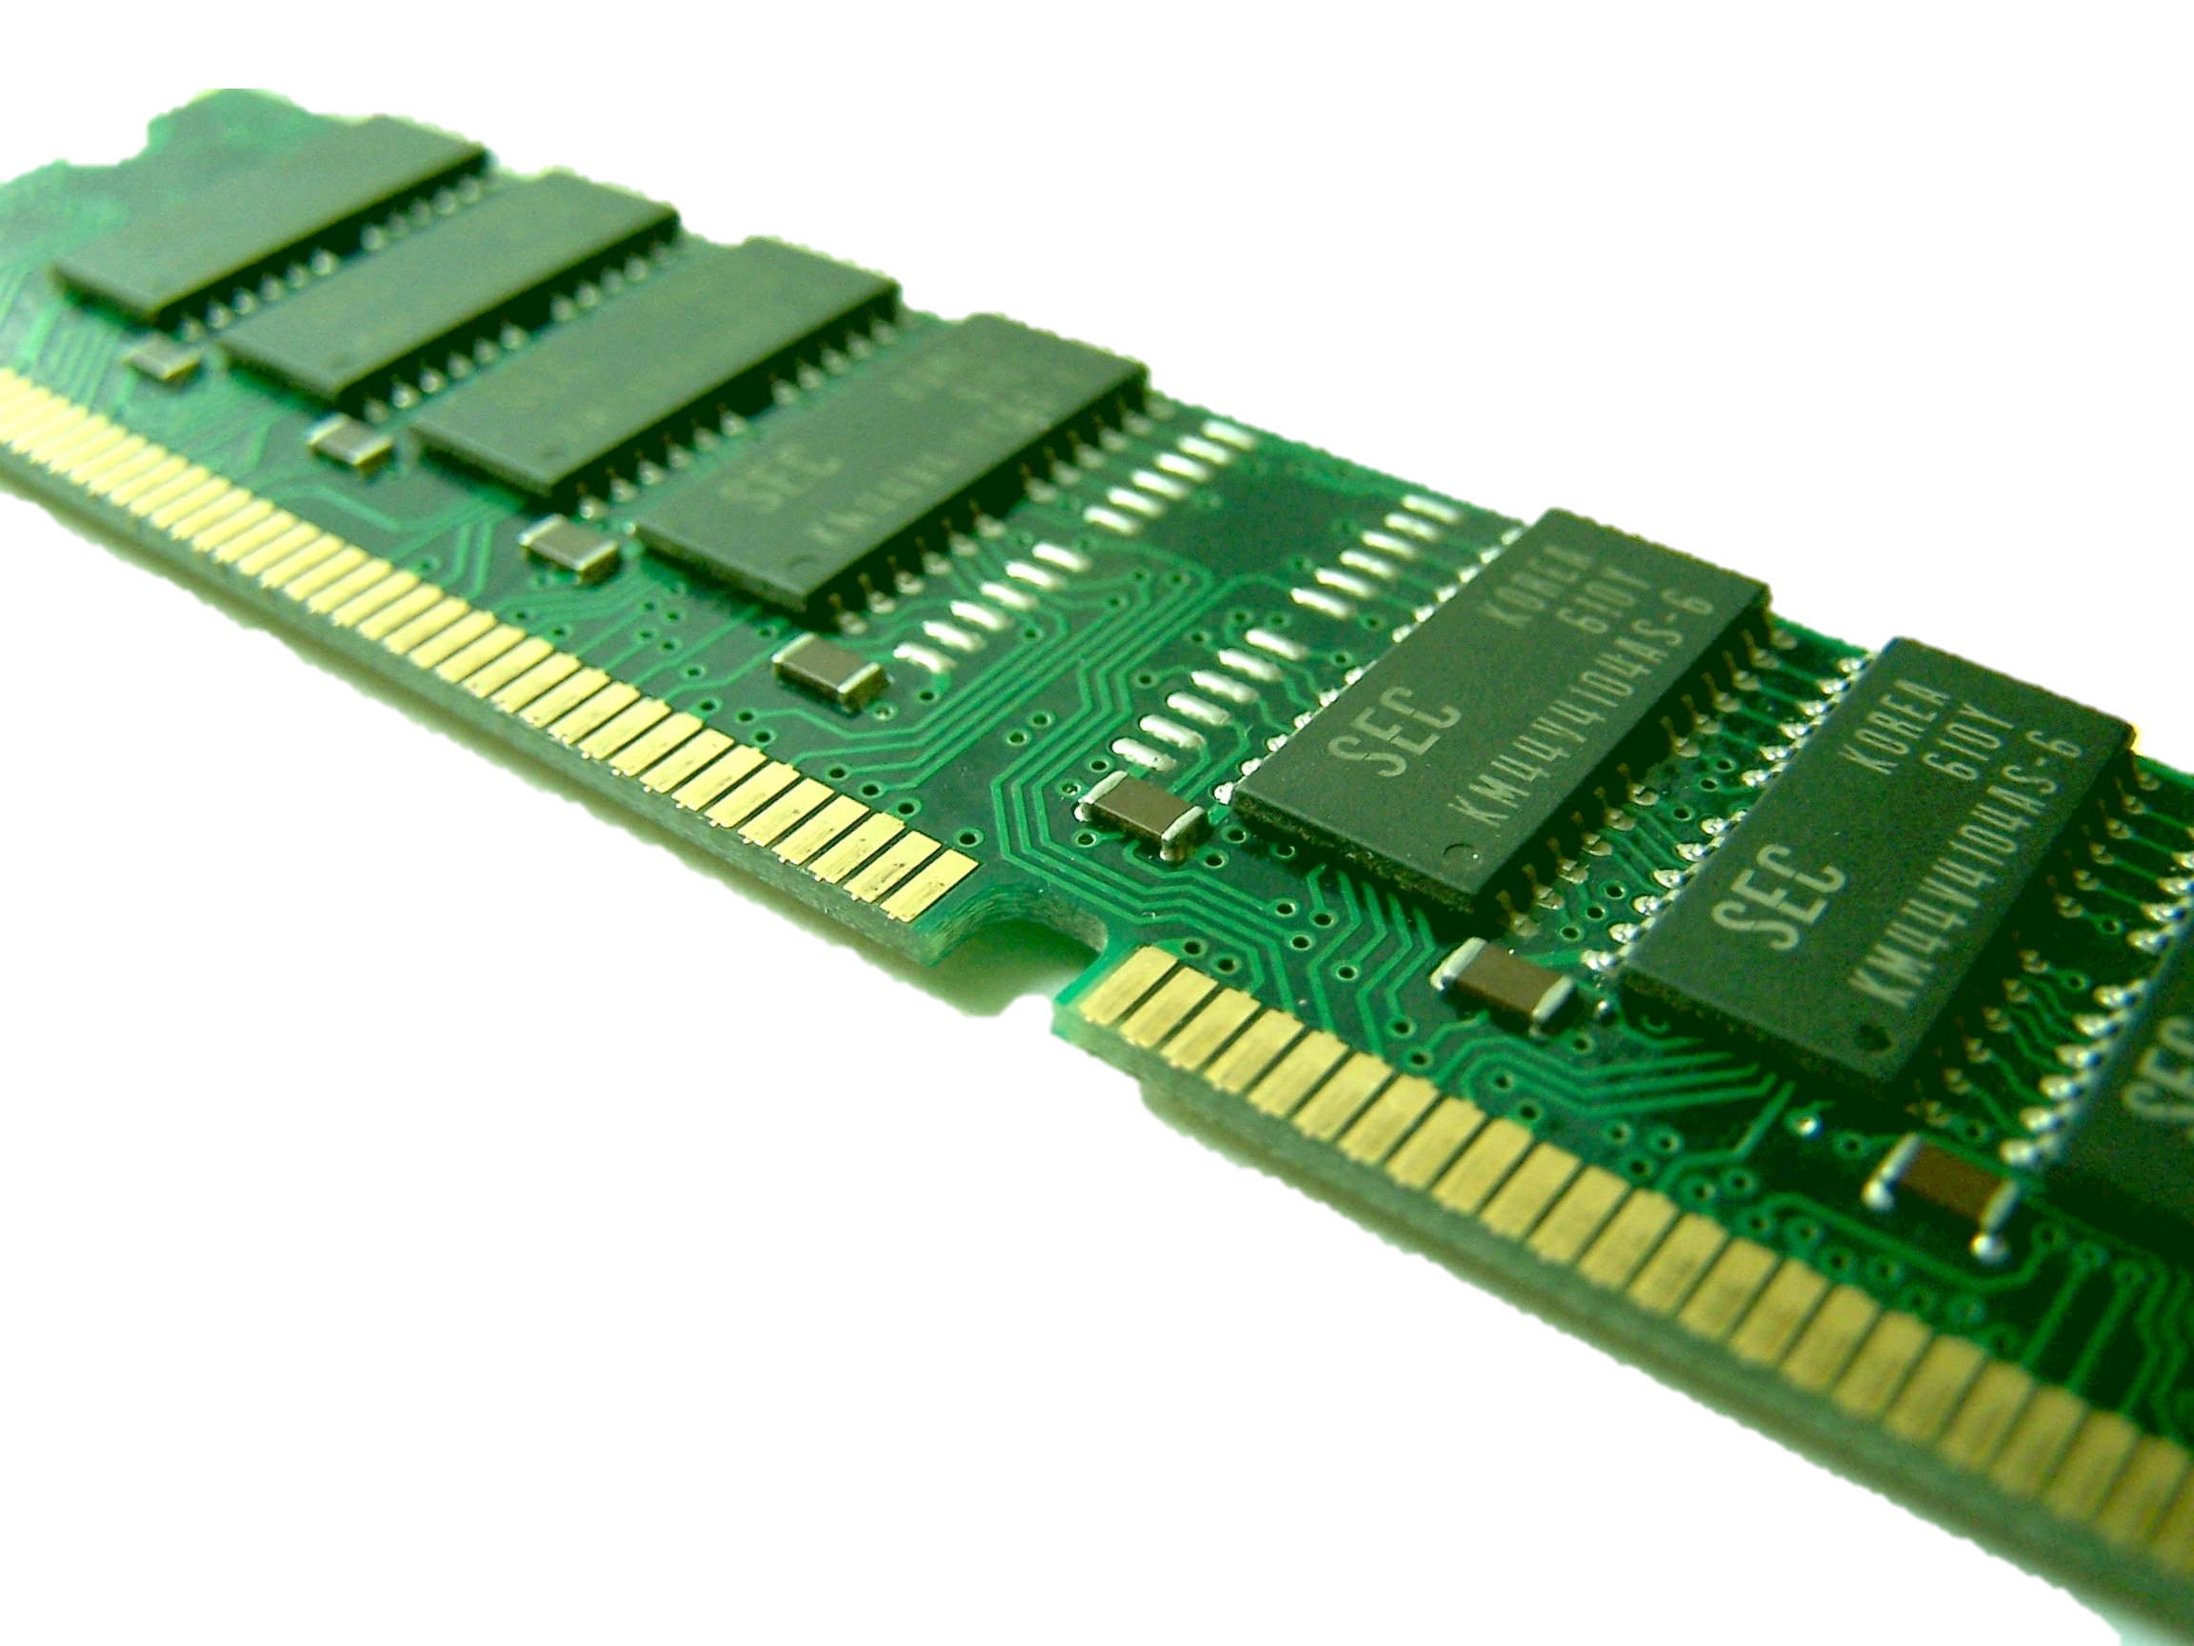
Process Scheduling
All programs are initially stored on a disk (Hard drive)
It has to move from a disk to memory
Then memory to the CPU
And the process can be reversed.

Slide 16
Process Scheduling
Take 5 stickers
We will watch (twice) a video on process scheduling
You will write down one question on one sticker, for a total of 5 questions
Then we will mix the questions and try to answer.

Slide 17
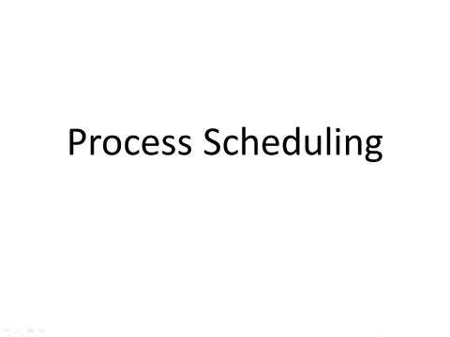

Slide 18
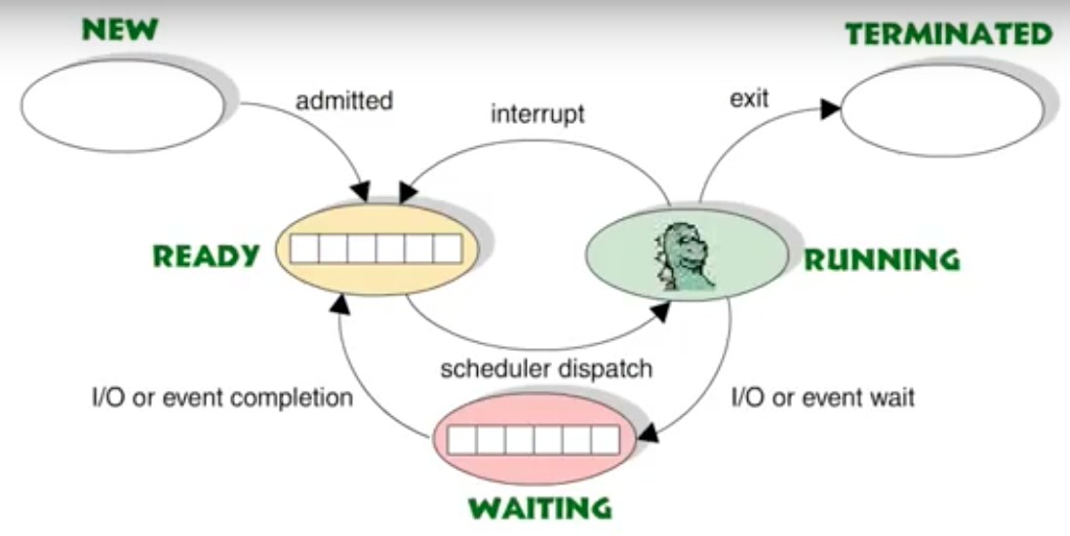
Process States

Slide 19
Process states
These are all the states a process can be in.
A single process can be split into different parts. These parts are called threads.
Each thread is treated as if it was a whole process

Slide 20
Interrupt
But sometimes a process is currently in a running state but then something happens – the process is interrupted.
Confusing terms: If an interrupt happens due to something relating to IO then it gets put in a waiting state. If its not related to IO then it gets put back into a ready state – its not running, its just ready to be run. The confusing bit is that sometimes this ready state is also called an idle state.
Cambridge: As far as they are concerned the above doesn’t happen. They say that every interrupt, based on IO or otherwise, puts the process in the waiting state.
Either way, when an interrupt happens the kernel must store the values that are in the registers. It stores the values in the Process Control Block (PCB) so it can be ready to run again later.
Remember the video, the Ready and waiting blocks are the PCB.

Slide 21
Video Task
Groups no more than 3.
Have to create a video that shows a physical example of the theory
So you can either use people to illustrate, physical items (blocks, paper, toys…)
No longer than 5 minutes
Must include an explanation poster (A4 or larger)
Pre-emptive and non-pre-emptive scheduling algorithms
First Come First Served
First In First Out
Round Robin
Priority Based

Slide 22
Memory Management
You decide prize. (KFC, skip schoology exam, chocolates….whatever)
You will watch a video about how an OS handles memory management.
The video is around 8 minutes
You can (must) take notes
After the video you will have to stand in front of the class.
And you will talk about how a OS handles memory management
Your speech should cover all the points covered in the video
But, in your talk I want you to say at least three inaccurate things (lie) about memory management
If a student picks up on your lie, then you are out. If you can get though your entire speech and no one picks up on your 3 (or more) lies then you win (KFC, chocolate…whatever.)
Only one winner. We will go in order.

Slide 23


Slide 24
Uncovered
One thing the video did not talk about was ‘disk trashing’
Say you got a page in RAM and a page on your virtual memory (hard drive)
Your page in RAM needs to access the page on your hard drive. It does this.
But now you page in hard drive needs to load something from RAM
And now RAM needs something from hard drive again
And now hard drive needs to load from RAM again
And now you are stuck loading and unloading pages.
This is disk trashing
It doesn’t happen so often but its in your course book so we should mention it

